Slide 1
Computer Networks
Khizar Mukhtiar
Department of Computer Science
National University of Computer & Emerging Sciences

Slide 2
Recap
Selective Repeat

Slide 3
TCP

Slide 4
TCP
TCP is a reliable transport layer protocol.
This means that an application program that delivers a stream of data relies on TCP to deliver the entire stream to the application program on the other end in order, without error, and without any part lost or duplicated.
In TCP, connection-oriented transmission requires three phases:
  Connection establishment
  Data transfer
  Connection termination.

Slide 5
TCP Features
TCP offers the following features:
  Establishes a Session:
    TCP is connection-oriented, negotiating and setting up a dedicated connection prior to data transfer to control traffic flow and manage communication.
  Ensures Reliable Delivery:
    TCP tracks transmitted segments and manages retransmissions to guarantee that all sent data reaches the destination intact without corruption or loss.

Slide 6
TCP Features
  Provides Same-Order Delivery:
    By numbering and sequencing segments, TCP ensures data arriving out of order over different network routes is reassembled correctly.
  Supports Flow Control:
    TCP prevents receiving host overload by managing data transmission rates based on available memory and processing power.

Slide 7
TCP Header
TCP is a stateful protocol which means it keeps track of the state of the communication session.
To track the state of a session, TCP records which information it has sent and which information has been acknowledged.
The stateful session begins with the session establishment and ends with the session termination.
A TCP segment adds 20 bytes (i.e., 160 bits) of overhead when encapsulating the application layer data.

Slide 8
TCP Segment Structure
32 bits
source port #
dest port #
ACK: seq # of next expected byte; A bit: this is an ACK
acknowledgement number
length (of TCP header)
head
len
not
used
A
P
S
receive window
flow control: # bytes receiver willing to accept
C
E
U
R
F
Internet checksum
checksum
Urg data pointer
options (variable length)
C, E: congestion notification
TCP options
application
data
(variable length)
data sent by application into TCP socket
RST, SYN, FIN: connection management

Slide 9
TCP sequence numbers, ACKs
outgoing segment from sender
Sequence numbers:
  Byte stream “number” of first byte in segment’s data
source port #
dest port #
sequence number
acknowledgement number
rwnd
checksum
urg pointer
window size
N
Acknowledgements:
  Seq # of next byte expected from other side
  Cumulative ACK
  sender sequence number space
sent
ACKed
sent, not-yet ACKed
(“in-flight”)
usable
but not
yet sent
not
usable
outgoing segment from receiver
source port #
dest port #
sequence number
acknowledgement number
A
rwnd
checksum
urg pointer

Slide 10

TCP Sequence Numbers, ACKs
Host A
Host B
User types‘C’
Seq=42, ACK=79, data = ‘C’
host ACKs receipt of‘C’, echoes back ‘C’
Seq=79, ACK=43, data = ‘C’
host ACKs receipt of echoed ‘C’
Seq=43, ACK=80

Slide 11
TCP Sequence Numbers, ACKs
Sequence Number (Seq): The byte number of the very first character in the segment, marking where this chunk of data belongs in the overall stream.
Acknowledgment Number (ACK): Represents the next expected byte from the sender (Calculated as: Received Seq + Bytes Received).
Cumulative Acknowledgments: An ACK value of N confirms the arrival of all preceding bytes up to N - 1.

Slide 12
TCP Sequence Numbers, ACKs
But how does the receiver actually figure out the exact length of incoming data?
¯\_(ツ)_/¯

Slide 13
TCP Sequence Numbers, ACKs
Payload Length Calculation: TCP lacks a payload length field, the receiver calculates data size using lower layers:
  Payload Bytes = IP Total Length - (IP Header + TCP Header)
ACK Calculation:
  Next ACK = Incoming Seq Number + Payload Bytes

Slide 14
TCP Sender
Event: data received from application
create segment with seq #
seq # is byte-stream number of first data byte in segment
start timer if not already running
  think of timer as for oldest unACKed segment
  expiration interval: TimeOutInterval
Event: timeout
retransmit segment that caused timeout
restart timer
Event: ACK received
if ACK acknowledges previously unACKed segments
  update what is known to be ACKed
  start timer if there are still unACKed segments

Slide 15
TCP Receiver
Event at receiver
arrival of in-order segment with
expected seq #. All data up to
expected seq # already ACKed
arrival of in-order segment with
expected seq #. One other
segment has ACK pending
arrival of out-of-order segment
higher-than-expect seq. # .
Gap detected
arrival of segment that
partially or completely fills gap
TCP receiver action
delayed ACK. Wait up to 500ms
for next segment. If no next segment,
send ACK
immediately send single cumulative
ACK, ACKing both in-order segments
immediately send duplicate ACK,
indicating seq. # of next expected byte
immediate send ACK, provided that
segment starts at lower end of gap

Slide 16
TCP Receiver
A duplicate ACK repeats the expected sequence number when out-of-order packets arrive or data is lost.
Mechanism:
  The cumulative ACK number stays paused at the missing segment.
  Receiver continuously ACKs the last successfully received in-order packet.
  Fast Retransmit Trigger: Receiving 3 duplicate ACKs prompts the sender to resend the missing packet immediately, bypassing the retransmission timer.

Slide 17
TCP Flow Control
TCP receiver “advertises” free buffer space in rwnd field in TCP header
  RcvBuffer size set via socket options (typical default is 4096 bytes)
  many operating systems autoadjust RcvBuffer
sender limits amount of unACKed (“in-flight”) data to received rwnd
guarantees receive buffer will not overflow
to application process
RcvBuffer
buffered data
rwnd
free buffer space
TCP segment payloads
TCP receiver-side buffering

Slide 18
TCP Flow Control
TCP receiver “advertises” free buffer space in rwnd field in TCP header
  RcvBuffer size set via socket options (typical default is 4096 bytes)
  many operating systems autoadjust RcvBuffer
sender limits amount of unACKed (“in-flight”) data to received rwnd
guarantees receive buffer will not overflow
flow control: # bytes receiver willing to accept
receive window
TCP segment format

Slide 19
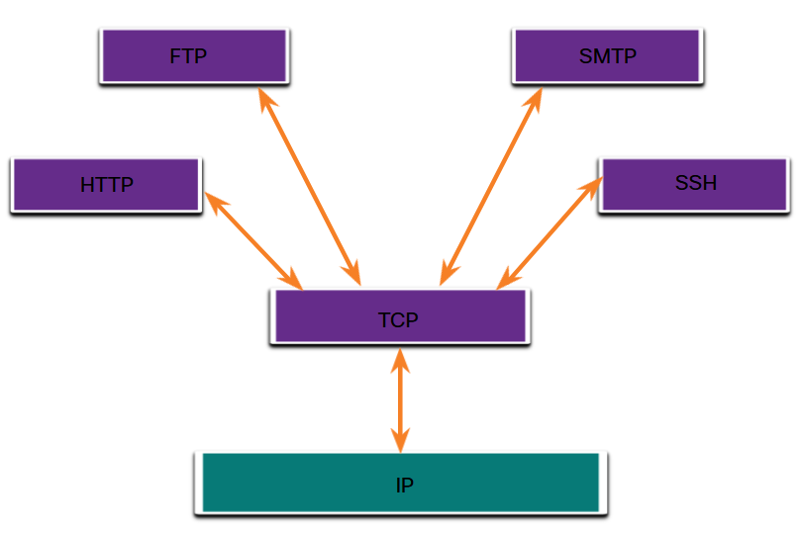
Applications that Use TCP
TCP handles all tasks associated with dividing the data stream into segments, providing reliability, controlling data flow, and reordering segments.
TCP frees the application from having to manage any of these tasks.
Applications can simply send the data stream to the transport layer and use the services of TCP.

Slide 20
TCP Connection Establishment
Initial Setup (Passive Open): Before a client connects, the server binds to a port and actively listens to open it for incoming connections.
Step 1 – SYN (Client to Server): The client sends a SYN packet to initiate the connection request and synchronize initial sequence numbers.
Step 2 – SYN-ACK (Server to Client): The server responds with a SYN-ACK packet, acknowledging the client's request while sending its own synchronization sequence number.
Step 3 – ACK (Client to Server): The client sends a final ACK packet back to acknowledge the server's response, completing the three-way handshake.
Outcome: Connection parameters are negotiated and acknowledged across these steps, establishing a reliable, full-duplex communication channel.

Slide 21
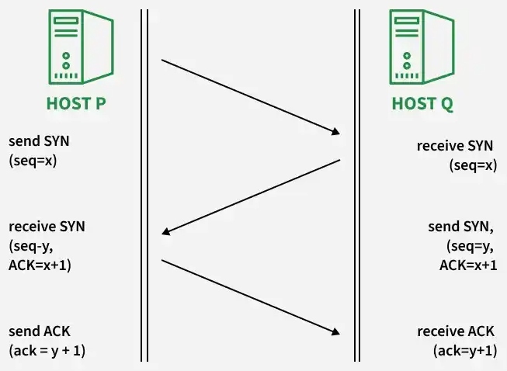
TCP 3-Way Handshake
Step 1 (SYN): Host P initiates the connection by sending a SYN segment with an initial sequence number seq=x. Host Q receives it.
Step 2 (SYN-ACK): Host Q acknowledges Host P's request (ACK=x+1) and sends its own sequence number (seq=y) in a single SYN segment. Host P receives this response.
Step 3 (ACK): Host P sends a final ACK (ack=y+1) to acknowledge Host Q's sequence number. Host Q receives it, completing the handshake and establishing the connection.

Slide 22
Closing a TCP Connection
Client, server each close their side of connection
  Send TCP segment with FIN bit = 1
Respond to received FIN with ACK
  On receiving FIN, ACK can be combined with own FIN
Simultaneous FIN exchanges can be handled

Slide 23
QUIZ

Slide 24
Host A and Host B are communicating over an established TCP connection. Host A needs to transfer a file of 3,600 bytes to Host B. Assume the following conditions: The initial sequence number chosen by Host A for this data transfer phase begins at Seq # = 10,000. The Maximum Segment Size MSS for this connection is 1,000 bytes. Host B sends an ACK immediately upon receiving each individual segment.
  Determine the number of TCP segments Host A will send to transmit the full 3,600-byte file. For each segment, list its Sequence Number and the range of byte numbers contained in its payload.
  For each segment received by Host B, state the ACK Host B will send back to Host A, assuming all segments arrive in order without loss. Explain what this ACK value signifies.
  Suppose Segment 2 is corrupted and dropped by the network, but Segments 1, 3, and 4 arrive safely and in order at Host B.
    What ACK number will Host B send upon receiving Segment 3 and Segment 4? What will be the Sequence Number and payload size of the segment Host A retransmits when it detects this loss?

